Slide 1
Activity Of Literary Genres For Class 3rd-10th

Slide 3
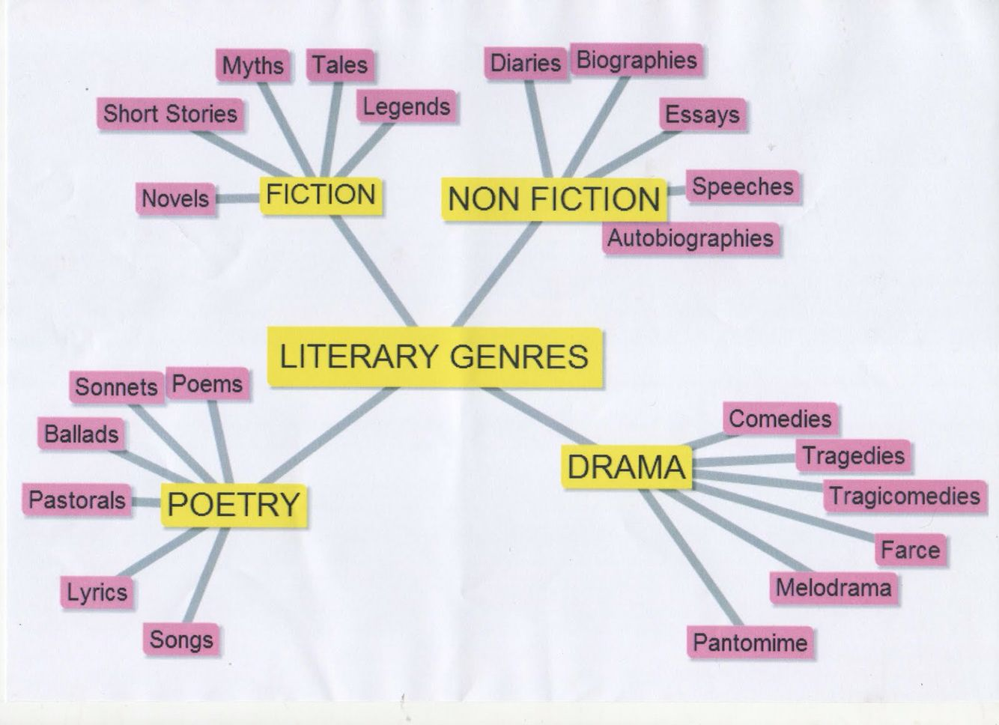

Slide 4
Class 9th and 10th

Slide 5
Science Fiction Science fiction is a genre composed of an author’s imagination to create futuristic settings, characters, and plot lines. Oftentimes authors extrapolate information from modern society to predict what future will look like.

Slide 6
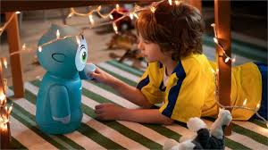
ACTIVITY You live in the future and everyone has a robot companion. Describe your robot and what it does for you.

Slide 7
Class 3rd-5th

Slide 8
FABLE Fables are a genre defined by the highlighting of human weaknesses or follies, often through the personification of animal characters. Lessons on morality and behavior are typically woven into these fictional stories.

Slide 9
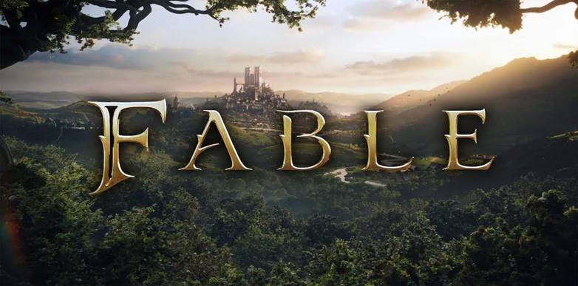
ACTIVITY Read several fables. Create a list of their tittles , which animal characters are used, and the lessons learned.

Slide 10
Class 6th-8th

Slide 11
AUTOBIOGRAPHIES Like biographies, autobiographies are nonfiction. They are written about a person, By the person! The author writes about themselves, telling their own life story . Incorporate some learning on prefixes to help students remember the difference between autobiographies and biographies. Auto is a Greek prefix that means “self”! Autobiographies are self written!

Slide 12
Class 6th Students will write biography of friend!

Slide 13
Class 7th Students will write biography of their favorite teacher!

Slide 14
Class 8th

Slide 15
ACTIVITY Have students write an autobiography about themselves! A great way to do this is a bio-poem!

