Slide 1
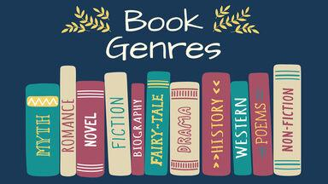
GENRES

Slide 2
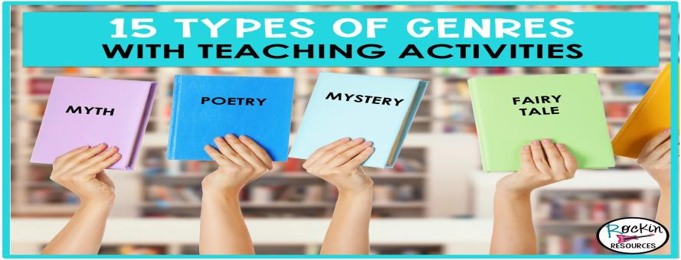
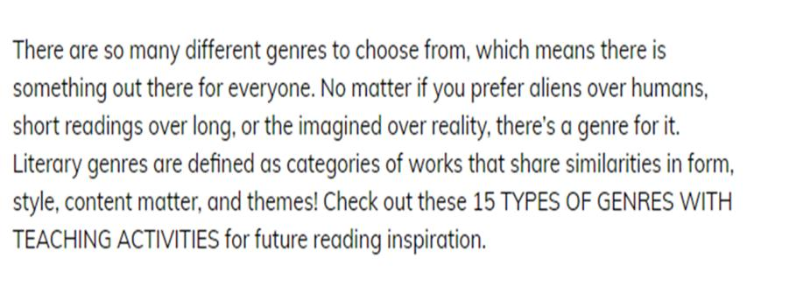
15 TYPES OF GENRES

Slide 3
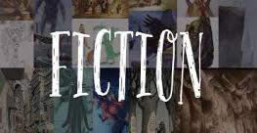
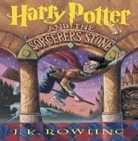
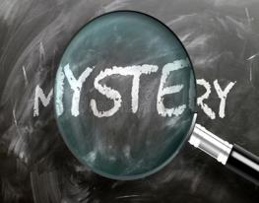
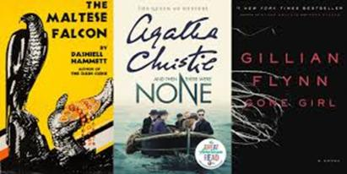
FICTION 1.FICTION: The genre of fiction is born out of the author’s own imagination. Although fictional literature may be based upon real people, events, or places, the genre itself is not considered factual. There are so may types of genres that fall under the fiction category.
2.MYSTERY: Mysteries area fictional genre where the “truth” of an event ,typically some sort of crime, remains unknown until the final moments of story. These storylines are riddled with clues, plot-twists, criminals, suspects, detectives, and eventually, a resolution to the problem.

Slide 4
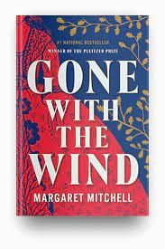
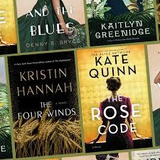
3.Historical fiction: The historical fiction genre includes stories that take place in the past. Often termed, “period pieces”, this genre aims to capture the specific details of a certain era, including customs, manners, traditions, and social norms of the past. Although historical fiction is set within a real time in history, the characters and action of the plot are often a combination of real (nonfiction) and fake (fiction) qualities. Historical fiction authors mean to authentically recreate an era, while also filling in the gaps and adding their own imaginative takes on the creation of the plot and characters.

Slide 5
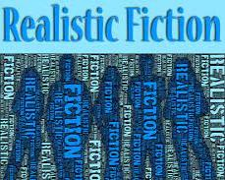
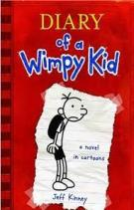
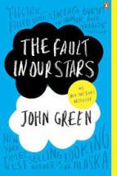
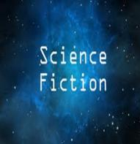
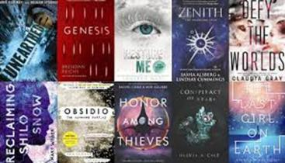
4.Realistic Fiction: Another branch of fiction is realistic fiction, which resembles real life and is composed of believable characters, probable plotlines, learned lessons, and realistic settings. 5.Science Fiction: Science fiction is a genre composed of an author’s imagination to create futuristic settings, characters, and plot lines. Oftentimes authors extrapolate information from modern society to predict what future will look like.

Slide 6
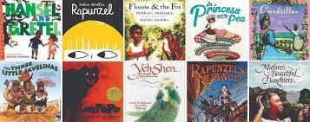
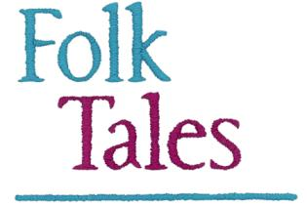
FICTION:TYPES OF FOLK TALES 6.Folk TALES: Folktales are traditional narratives that have been passed down via the practice of storytelling. These fictional stories include characters, settings, and central problem. Think of folk tales as a big umbrella under which other genres like myths, fairy tales, legends, fables, and tall tales.

Slide 7
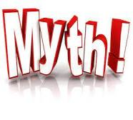
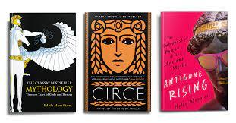
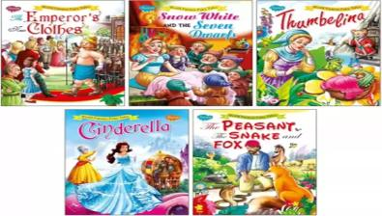
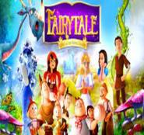
7.MYTH: Myth is a fictional genre that is best defined by the presence of supernatural elements and/or characters within the plot. Mythical storylines explain natural or social phenomena and are typically rooted in the ancient tradition of storytelling.
8.FAIRY TALE: Fairy tales are fictional tales with magic infused stories that feature fantastical characters like wizards, goblins, elves, fairies, princesses, and witches! Fan-favorite fairy tales include Cinderella, Hansel and Gretel, and Snow White.

Slide 8
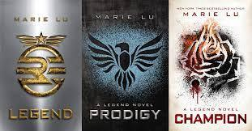
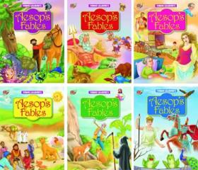
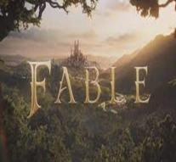
9.LEGEND: Legends are fictional stories that have social verisimilitude, meaning they are typically more “realistic” than mythical storylines that are full of supernatural elements. Moreover, legends often feature actual historical events and people.
10.FABLE: Fables are a genre defined by the highlighting of human weaknesses or follies, often through the personification of animal characters. Lessons on morality and behavior are typically woven into these fictional stories.

Slide 9
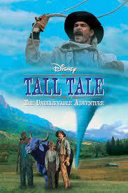
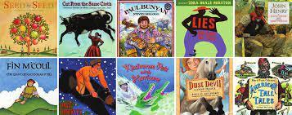
11.TALL TALE: Tall Tales are fictional narratives with unbelievable and extremely exaggerated elements. Take the story of gigantic duo, Paul Bunyan and Babe the Blue Ox, for example!

Slide 10
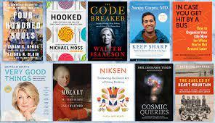
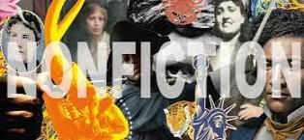
NON-FICTION 12.NON-FICTION: Nonfiction is a genre of literature that presents itself as truthful and factual. Within this genre, all information, events, and people are discussed with great accuracy. Unlike fictional stories, non-fictional pieces provide readers with information and descriptions of true events or people. To remember which is which, think of nonfictional as Not-Fake!

Slide 11
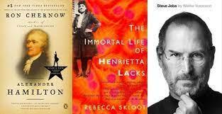
13.BIOGRAPHY: Biographies are nonfictional pieces defined by an author’s narration of another person’s life. To produce credible biographies, authors must utilize reliable sources to compose an accurate and fair account of another person’s life story.

Slide 12
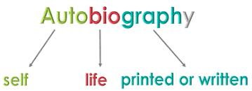
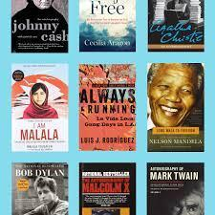
14.AUTOBIOGRAPHIES: Like biographies, autobiographies are nonfiction. They are written about a person, By the person! The author writes about themselves, telling their own life story . Incorporate some learning on prefixes to help students remember the difference between autobiographies and biographies. Auto is a Greek prefix that means “self”! Autobiographies are self written!

Slide 13
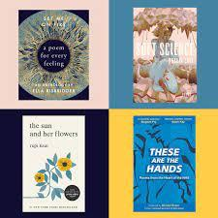
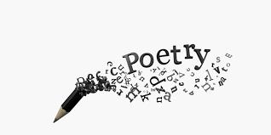
POETRY 15.POETRY: Poetry is a symbolic form of writing that evokes great imagination in the frequent expression of human experiences and emotions. Commonly used poetic tools include metrical writing n the form of verse, which can be enhanced through rhyme schemes and rhythmic meters.

